Slide 1
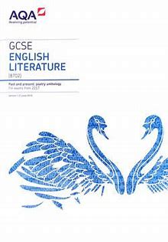
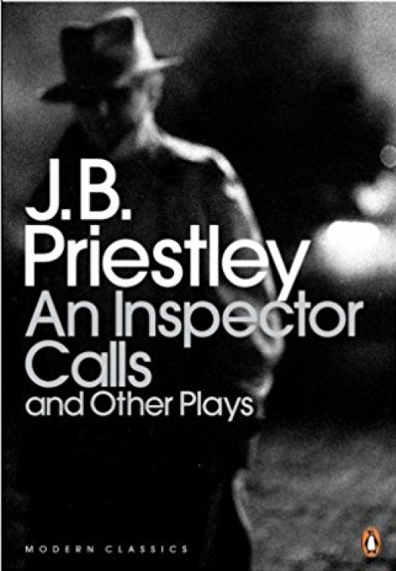
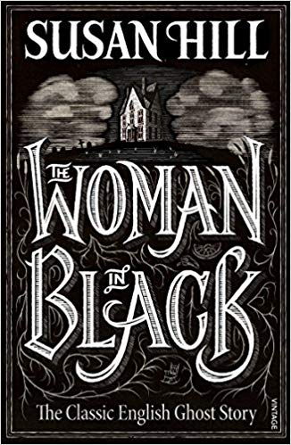
7
Revision timetable:
Keep using your revision timetable to ensure that you’re prepared for every aspect of the English exams
Are you completing exam style questions under timed conditions?
English Literature and English Language GCSE exams
Mock exams
Language Paper 2 and Literature Paper 2
Revise: Anthology and unseen poetry and ‘An Inspector Calls’
Continue your lifelong love of literature, language and learning
Where will English take you?
Travel and tourism
Performing arts
Teaching
Journalism
Advertising
Media and marketing
GCSE Results
Are you acting on feedback from your class teachers?
Language Paper 1
Read fluently and with good understanding a wide range of fiction texts.
Literature interleaved
Act on personalised Literature and Language Paper 1 feedback from your teacher
YEAR
11
Mock exams
Language Paper 1 and Literature Paper 1
Language Paper 2
Read and evaluate texts critically, making comparisons between texts.
You will create and present your own presentations for the Spoken Language Endorsement element of the course.
Unseen poetry
You will study a wide range of poems and you will learn how to analyse and evaluate methods used by the writers.
Mock exams
Literature Paper 1 and Literature Paper 2
Start to develop independent study habits
Power and Conflict poems from the Anthology and Unseen poetry
You will study a range of poems from different eras each focusing on an aspect of power or conflict.
‘An Inspector Calls’
You will explore Priestley’s post-war play learning the importance of the relationship between the text and the context in which it was written.
‘Romeo and Juliet’
Building on your prior experience of plays, you will evaluate how meaning is created for the audience through a range of dramatic devices.
‘A Christmas Carol’
Building on your prior knowledge of the supernatural genre, you will explore how Dickens creates meaning through a variety of methods.
What are the conventions of Gothic literature?
How does the writer use language, structure and form to create meanings?
What is the relationship between text and context?
YEAR
10
End of year assessments
Voices from Beyond
Gothic Fiction: You will read Susan Hill’s ‘The Woman in Black’ focusing on the key conventions of gothic literature.
Voices of Conflict:
You will study a wide range of poetry on the theme of conflict to develop your understanding of the wider world
You will study famous speeches from different points in history emerging from conflict and you will learn to write your own speeches.
You will explore work from a range of writers and use them as style models to write your own creative responses.
What was life like in 1930s America?
Was it a fair society?
Can the ending of the novella be viewed optimistically?
YEAR
9
Finding a Voice:
You will be thinking about what it would it be like to live in a sexist and racist society where there is little hope of escaping.
You will be assessed on your reading writing and spelling skills upon entrance to the school to inform setting.
‘ ACHIEVE EXCELLENCE’

