Slide 1
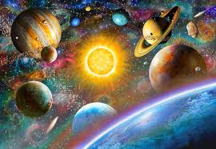
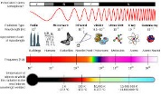
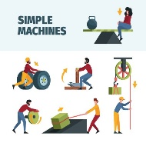
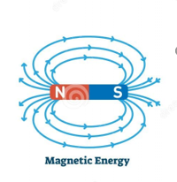
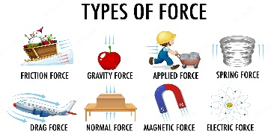
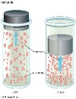
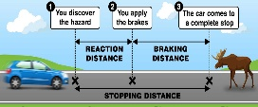
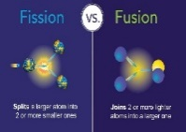
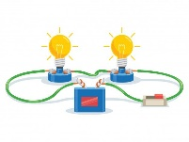
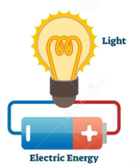
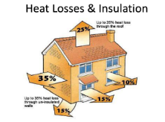
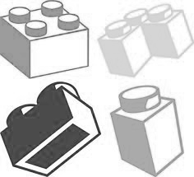
7
Are you completing exam style questions under timed conditions?
Half term 4 Spring
Revision of:
Energy
Electricity
Particle model of matter
Atomic structure
Forces
Waves
Magnetism and Electromagnetism
Space Physics
Where will Physics take you?
Astronomy and Space
Meteorology
Medical Physics
Education
Engineering
Finance
Are you attending revision classes?
GCSE exams
Physics paper 1 and paper 2
Continue your lifelong love of learning
Revision timetable:
GCSE Results
Are you acting on feedback from your class teachers?
Ensure you refer to your QLA sheets
Half Term 1 Autumn
Magnetism
Magnets and magnetic fields
Currents and fields
Currents and forces
Motors
Half term 3 Spring
Space Physics
The solar system
Life cycle of a star
Orbits
Red shift
Mock exams
Physics paper 1 and paper 2
How science works skills woven through the year to refine practical and analytical skills
Are you attending revision classes?
YEAR
11
Mock exams Physics paper 1
Half term 2 Autumn
Magnetism
Electromagnetic induction
Generators
Transformers
Microphones
Half term 4 Spring
Forces and motion
Turning forces
Simple machines and Hydraulics
Are you attending revision classes?
Half term 6 Summer
Waves
Dangers of the Electromagnetic spectrum
Lenses
Light and colour
Are you completing exam style questions under timed conditions?
Half term 5 Summer
Waves
Sound uses and properties
Electromagnetic spectrum
Uses of the Electromagnetic spectrum
Revision timetable:
Start to develop independent study habits
Half term 2 Autumn
Forces and motion
Newton's Laws
Momentum
Work and power
Stretching springs
Gravitational potential energy
Half term 3 Spring
Forces and motion
Distance, time and speed
Vectors and scalars
Acceleration
Motion graphs
Equations of motion
Half term 1 Autumn
Atomic structure
Radioactivity
Atoms and isotopes
Alpha, Beta and Gamma
Nuclear equations
How science works skills woven through the year to refine practical and analytical skills
YEAR
10
End of year assessment
You will sit a formal examination in all three sciences that will then be used as a basis for Year 10 setting
Half term 6 Summer
Matter
Atomic model
Density
Specific heat capacity
Pressure
Floating and sinking
.
Half term 2 Autumn
Atomic structure
Half life
Radiation and its effects
Nuclear Fission
Nuclear Fusion
Half term 5 Summer
Electricity
Circuit component
Resistance
Sensing circuits
Electrical power
Half term 4 Spring
Energy sources
Energy conservation
National Grid
Efficiency
Half term 5 Summer
Electricity
Electrostatics
Simple circuits
Series and parallel circuits
Half term 3 Spring
Energy
Energy stores
Energy transfers
Energy analysis
Walls and insulation
Efficiency
Baseline assessments to inform setting
Half term 1 Autumn
KS3 Heat Energy and renewables, Electricity
YEAR
9
YEAR
You will study a range of topics across all three sciences. The Biology, Chemistry and Physics topics are common to all in Year 9
Half term 2 Autumn
KS3, magnetism, waves and light
Build a solid foundation in education
WOODHOUSE ACADEMY/JAMES BATEMAN
PRIMARY
SCHOOL
Sit SATS in
Y6
Develop a lifelong love of learning
‘ Achieve Excelence.’

Slide 2
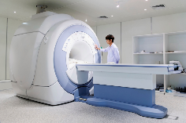
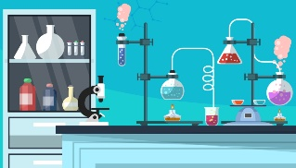
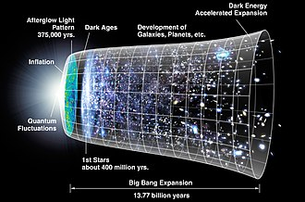
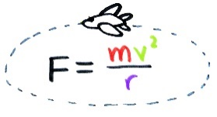
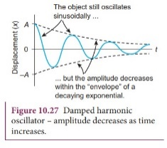
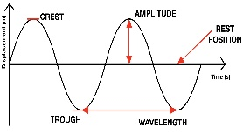
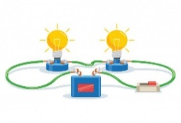
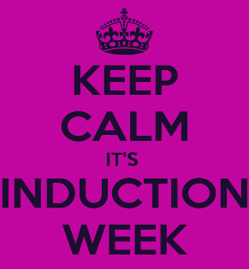
7
Moving onto university or degree level apprenticeships
Where will Physics take you?
Astronomy and Space
Meteorology
Medical Physics
Education
Engineering
Finance
Continue your lifelong love of learning
Summer
Year 13
Entering the world of work
A level results
Results day
Successful UCAS application confirmation or going through clearing
Examination technique refined through revision
Half term 5 Summer
Medical physics
Revision for final examinations
Half term 6 Summer
Completion of final examinations
Summer examinations
Modelling Physics
Exploring Physics
Unified Physics
Half term 4 Spring
Particle physics
Radioactivity
Nuclear Physics
Continue to develop independent study habits
Half term 3 Spring
Capacitance
Electric fields
Magnetic fields
Half term 2 Autumn.
Gravitational fields
Stars
Cosmology
Are you completing exam style questions under timed conditions?
Practical endorsement work completed throughout the course
Half Term 1 Autumn
Circular motion
Oscillations
Half term 6 Summer
Thermal physics
Ideal gases
Circular motion
Revision timetable:
Research PAG issued
Practical endorsement work completed throughout the course
YEAR
Practical endorsement work completed throughout the course
13
Consolidation of Y12 work going into Y13.
End of year assessment
You will sit a formal examination in Y12 that will assess your suitability to continue the course in Y13
Are you completing exam style questions under timed conditions?
Half term 2 Autumn.
Work, energy and power
Materials
Laws of motion and momentum
Half term 4 Spring
Waves 1
Waves2
.
Half term 5 Summer
Quantum physics
Mock revision
Y12 Mock
Half term 1 Autumn
Foundations of Physics
Motion
Forces in action
Continue to develop independent study habits
Half term 3 Spring
Charge and current
Energy power and resistance
Electrical circuits
GCSE examinations
Revision timetable:
You will study a range of topics across both years. Building
Start to develop independent study habits
Bridging tasks to be completed and handed in
YEAR
12
Year
11
Y11 Induction week
You will get the chance to have taster lessons to see if the A Level course is right for you
Build a solid foundation in education
Secondary school
Mocks in Y11, information from these can help to inform your choices for A Level
Develop a lifelong love of learning
‘ Achieve Excelence.’

