Slide 1
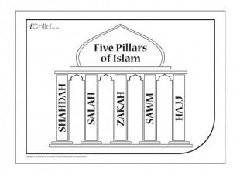
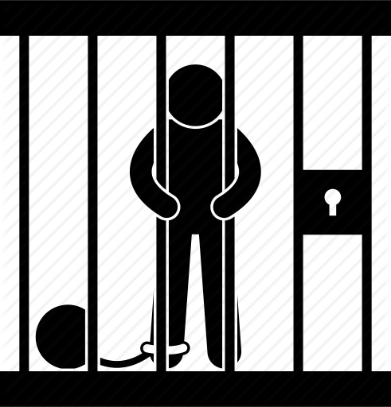
Religious Studies
What is evil?– The first lessons we look at, focusses on identifying just what acts are evil and then looking at how good can come from evil.
Extremist views: What are extremist views? Why do they exist? How do we tackle these views?
Parables: What are parables? How do they affect someone’s moral guidance?
The four wives: Through this story we focus on the importance of looking after our soul as much as looking after our appearance.
The Qur’an: What is the Muslim Holy book? What religious figures are important in their religion?
Allah and Muhammad: We focus on these key religious figures within Islam. Focussing on the morals and teachings they provide.
Year 9 will build on the skills and content knowledge they acquired in your middle school
Year
9
The Five Pillars of Islam: What are they? Why are they important? How do Muslims use them?
ISLAM: The next unit we study focusses on Islam. Here we tackle misconceptions as well as focussing on the main core beliefs of the religion.
FORGIVENESS - The final unit in Year 9 focusses on forgiveness and tackles how forgiveness can be so hard in some circumstances.
Peace– The last tasks in this unit focus on trying to live peacefully. But first we explore why peace is so hard to achieve.
WHAT IS BELIEF? The 2nd unit we study in Year 9 focuses on belief. What people believe in, how we gain our moral teachings.
GOOD AND EVIL– In this unit you will explore what is seen as good and evil. How the Bible teaches stories on good and evil. As well as exploring how we are taught this from an early age.
Adam and Eve: You will examine the Adam and Eve Bible story and explore how the Bible teaches this important life lesson.
Why forgive: Our final lesson in Year 9 ties everything together and focusses on our own views towards forgiveness, religious or not.
What are your views on forgiveness? What things have you not been able to forgive?
The purpose of punishments – the first three lessons explore the concepts of why we need laws in the first place. The types of punishments used and the purpose that these have for society.
Year
10
Religious views o forgiveness:
Why are some religious people able to forgive yet some cannot? Shouldn’t all religious people forgive everyone and everything?
Religious view on punishments: we explore the Christian and Muslim view on punishments with focus on teachings from the Bible and Qur’an
CRIME AND PUNISHMENT:
The first topic focuses on justice and punishment. We focus on the purpose of punishments as well as the religious views towards punishments. Consuming energy resources
A song for Jenny: We will study the example of one of the victims from the terrorist attacks in London and how her family struggled to forgive her killers.
Hotel Rwanda: We spend two lessons looking at Hotel Rwanda and the conflicts that arose during the civil war. Focussing on all of the concepts we have covered so far, crime and punishment, human rights etc.
Euthanasia and Capital Punishment: Within the topic we look at the reasons behind taking a persons life – be it assisted suicide or as a death sentence punishment, exploring the religious views towards this.
Why wars occur: We study the conflict in Northern Ireland between Protestants and Catholics as well as the Arab Israeli conflict.
HUMAN RIGHTS: Our second topic identifies the issues surrounding human rights and the abuse of these rights.
Religious views towards Human Rights: We explore the Christian and Muslim view towards human rights and again focus on the teachings in the Bible and Qur’an.
How are human rights being abused? The final area of the second unit focuses on how human rights are being abused and how we can try and tackle the issue.
Rules for war: We investigate the difference between a “just” war and a “holy” war and look at the different rules for engagement for Christians and Muslims.
Why is world peace so hard to achieve? Our final lesson culminates around the issue of why peace is such a hard thing to achieve and what could religious and non religious people do to improve relations.
THE FINAL TOPIC IS WAR. Throughout this unit we focus of the causes of war and the rules on engagement.

